Slide 1
1
Node 1
2
Node 2
3
Node 3
4
Node 4
5
Node 5
τ1 local updates
τ2 inter-node communications
W₃
3
Node 3
Step 1 | ( W₂ + W₃ + W₄ ) / 3
Step 2 | ( W₁ + 2 W₂ + 3 W₃ + 2 W₄ + W₅ ) / 9
Step 3 | ( 4 W₁ + 6 W₂ + 7 W₃ + 6 W₄ + 4 W₅ ) / 27
Step 4 | (14 W₁ +17 W₂ + 19 W₃ + 17 W₄ + 14 W₅ ) / 81
W₂
2
4
W₄
W₅
1
5
W₅
DF-Learning0.png

Slide 2

“propagation” eco-law
Neighbor nodes of current Node
NB 1
NB 2
…
NB n
Aggregtion
Aggregtion
Aggregtion
Current
Node
Aggregtion
<<-- Received model data
Sent model data -->>
“aggregation” eco-law
Model data of current node
Model data of NB 1
update
Model data of NB 2
Aggregated model data
Model data of current node
…
Model data of NB n

Slide 3

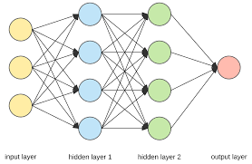



…
W₂
W_{k}
node_{k}
node₂
(K in range [2..p])
W_{p}
W₁
node_{p}
Central server
node₁
Average aggregation:
Σ(n_{k}/ n_{total} )*W_{k}
⁽n_{total} = Σ n_{k}⁾
p
k=1
p
k=1
Federated-learning01.png

Slide 4









Implementation of Gossip Federated Learning with the coordination model
GED 1
GED 2
GED n
Neighbouring Edge Devices
Learning twin
Learning
Model
Learning twin
Learning
Model
Learning twin
Learning
Model
…
Coordination platform
Coordination platform
Coordination platform
W$j$^{k,1}
…
W$j$^{k,2}
W$j$^{k,n}
GED 1,2, … n Learning model weights
GED k Model weights
GED k Model weights
GED k Model weights
GED 1 Model weights
GED 2 Model weights
GED N Model weights
GED k
Aggregation applied to leaning model weights:
Spreading
W$j$^{k}
W$j$^{k,1}
W$j$^{k,2}
W$j$^{k,n}
All GED learning models have the same structure.
W_{j+1}^{k}
Aggregation mechanism
Bonding
Each GED manages model distribution and aggregation.
Decay
Model weights
W_{j}^{k}
Coordination platform
Mechanism generalised to any model : aggregation functions defined in learning model
Learning twin
Learning
Model

Slide 5
Gossip Federated Learning : experimentation
Model applied on single GEDs and GEDs clusters
Experimentations with Markov chains and LSTM models
Use of topologies with 2 and 4 GEDs
Comparison of 4 different aggregators : sampling number, power loss, min loss, GED power profile

Slide 6
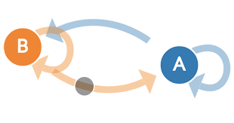
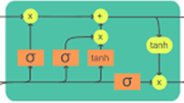
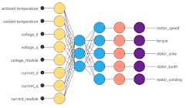
Implementation of Gossip ensemble Learning with the coordination model
Neighbour 1
learning model
Neighbour 2
learning model
Neighbour n
learning model
(1)
calculation of predictions
…
NBR-1 Prediction
NBR-2 Prediction
NBR-n Prediction
Coordination platform
Coordination platform
Coordination platform
Neighbour¹
Neighbour²
Neighbour^{n}
(4)
(2)
(4)
(2)
(4)
-> Spreading
Reception ->
Spreading <-
Reception ->
-> Spreading
<- Reception
(2)
Spreading
Local
Prediction
NBR-1 Prediction
NBR-2 Prediction
NBR-n Prediction
(2): Reception of predictions from direct neighbours
(3): Aggregation of all predictions
(4): Spreading of local predictions to direct neighbours
Local Prediction
Aggregation mechanism
Bonding
(3)
Decay
Local
Prediction
Coordination platform
Local Learning
model
Local node
gossip_ensemble_learning.png

Slide 7
Gossip Ensemble Learning : experimentation
Model applied on a single GED and on a GEDs cluster
Experimentations with Markov chains on GED-1 and LSTM models on GED-2
Comparison of 2 different aggregators : last power and power history

Slide 8



compacted LM-1
compacted LM-2
[for i in range 2 to n]
compacted LM-n
(1): unpack received models
unpack
unpack
unpack
“Full” Learning Model-1
“Full” Learning Model-2
[for i in range 2 to n]
“Full” Learning Model-n
(2) : aggregate “full” models
Aggregation of “Full” learning models
aggregated
“Full” learning model
(3):pack aggregated model
pack
Aggregation of compacted Learning models
compacted aggregated LM
unpack_LM.png

Slide 9
Composed
Patterns
Gossip
Basic
Patterns
Bonding
Decay
Aggregation
Spreading

